Slide 1
Cryptography: Exploiting the GPU
By: Aleksandr Kibis
CSC746
6/22/14

Slide 2
What is Cryptography?

Slide 3
Applications

Slide 4
Parallel Nature

Slide 5
Problem

Slide 6
GPUs to Save the Day

Slide 7
Which Architecture?

Slide 8
Secure Hash Algorithm (SHA)
Keccak selected by NIST for SHA3
In the sponge function family
  In
    Input file of any desired length
  Out
    Hash of any desired length
How?
  Exclusive bitwise operations (XOR)

Slide 9
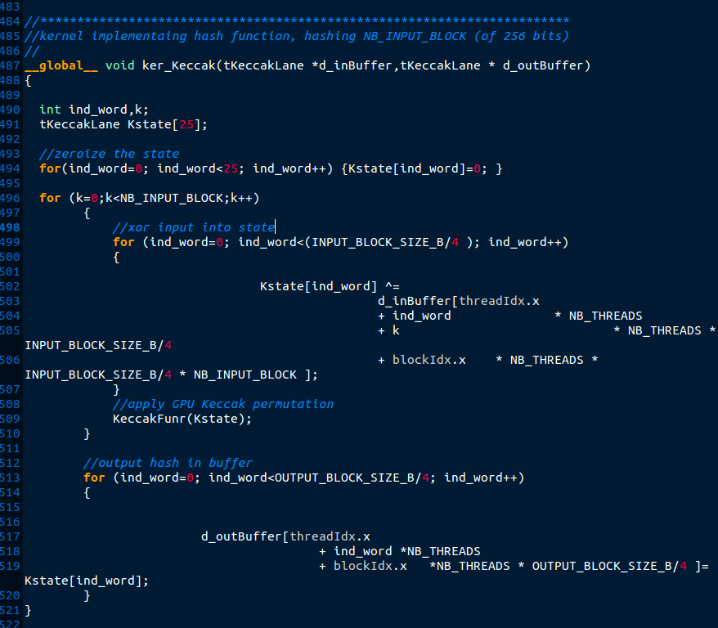

Keccak: CUDA
Assuming that a discrete GPU is used (8800 GT or above)
  45-80X faster hashing
16MB/s vs 1GB/s
Source code provided by: Guillaume Sevestre

Slide 10
Cryptocurrency
Slothcoin implements SHA3 for its encryption

Slide 11
Advanced Encryption Standard (AES)
Symmetric encryption
Standard is set by the NSA
Secret
  128, 192, and 256 bit
Top Secret
  192 or 256 bit

Slide 12
AES: OpenCL

Slide 13
Wireless Networking
Unencrypted data can be sniffed
  WireShark
  AirCrack
Used to encrypt data stream between router and computer
AES is the most secure with least overhead
  WEP (10%)
  WPA-PSK (17%)

